Slide 1

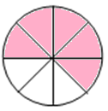


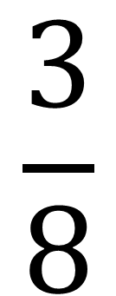
$$\frac{3}{8}$$
$$\frac{1}{4}$$
$$\frac{5}{8}$$

Slide 2


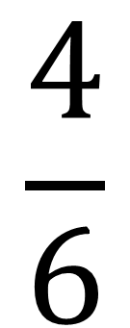

$$\frac{2}{5}$$
$$\frac{1}{3}$$
$$\frac{4}{6}$$

Slide 3


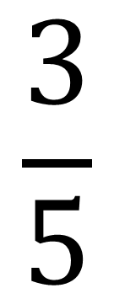
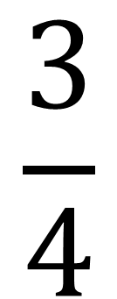
$$\frac{3}{4}$$
$$\frac{1}{2}$$
$$\frac{3}{5}$$

Slide 4


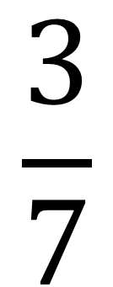
$$\frac{3}{7}$$

